Slide 1
Baseband Pulse Transmission

Slide 2
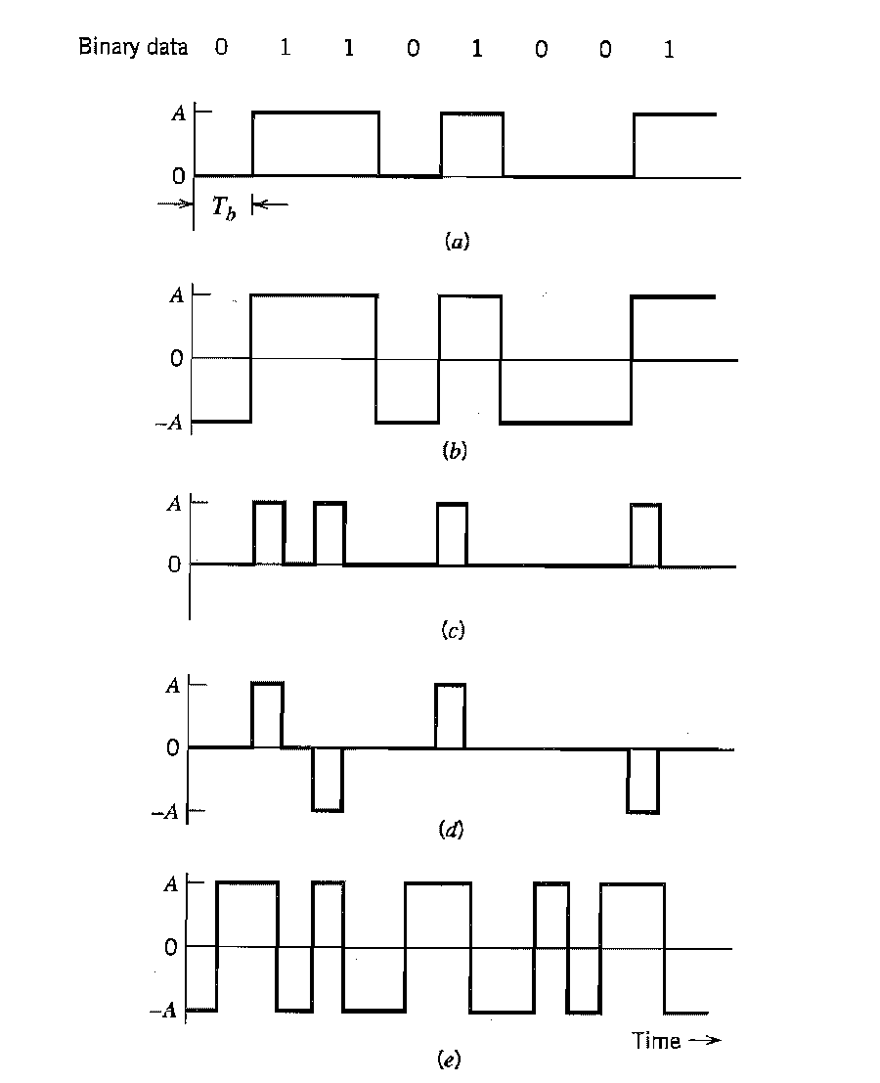
Line Codes
Unipolar NRZ (b) polar NRZ (c) unipolar RZ (d) bipolar RZ
(e) Manchester code

Slide 3
Differential Encoding
Unipolar NRZ

Slide 4
Inter symbol Interference (ISI)
Incoming binary sequence b_{k} consists of 1 and 0, each of duration T_{b.}
PAM modulator maps b_{k} as a_{k}

Slide 5
Inter symbol Interference (ISI)
The receive filter output y(t) can be written as
Where μ is scaling factor.
Pulse p(t) is normalized by setting p(0)=1.In frequency domain
The receiver output y(t) is sampled at time t_{i}=iT_{b}

Slide 6
Nyquist Criterion for zero ISI
If p(t) satisfy above condition ,then
Above equation indicates zero ISI.
Sampling in time domain produces periodicity in frequency domain
Where is bit rate.

Slide 7
Nyquist Criterion for zero ISI
Let m=i-k, then i=k corresponds to m=0 and likewise i≠k corresponds to m≠0. imposing these conditions we get
Thus, == = p(0)
or
Since p(0)=1

Slide 8
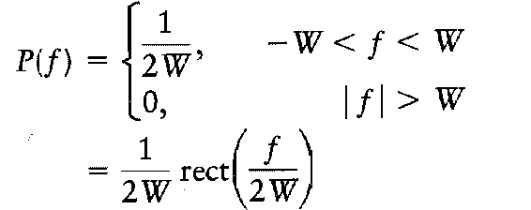
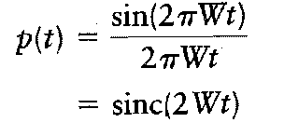
Ideal Nyquist Channel
Where rect(f) is rectangular function of unit amplitude and overall system bandwidth is given by W= R_{b}/2 = 1/2T_{b,} thus for zero ISI no frequency component should exceed half of bit rate.
In Time domain

Slide 9
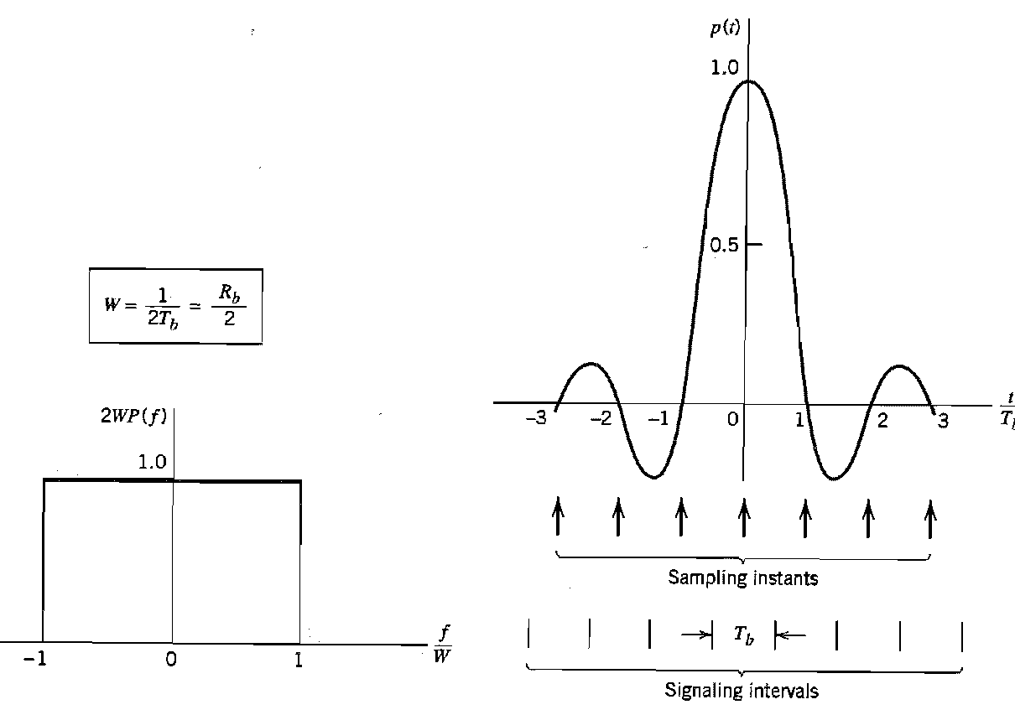
P(f) P(t)

Slide 10
Raised Cosine Spectrum
The raised cosine spectrum that follows above equation is given by
The roll-off factor α is given by

Slide 11
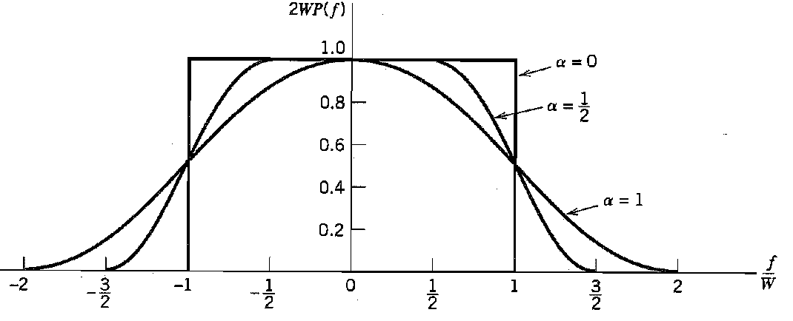
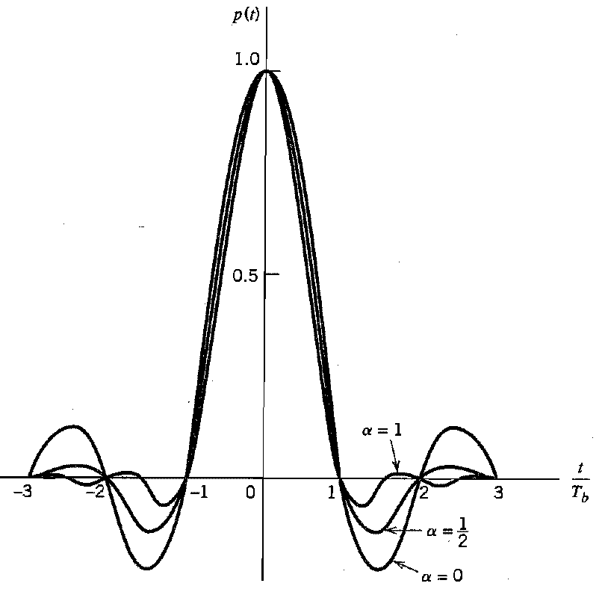
Raised Cosine Spectrum
The frequency response p(f) is normalized by multiplying with 2W.

Slide 12
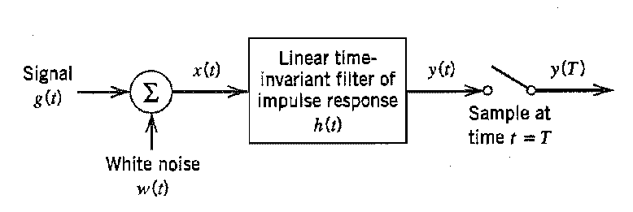
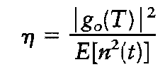
Matched Filter
For the receiver shown below.
Peak pulse signal to noise ratio
Measure h(t) to get maximum η

Slide 13
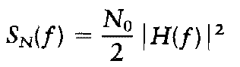
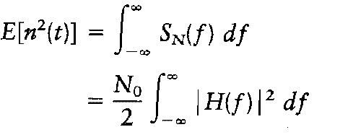
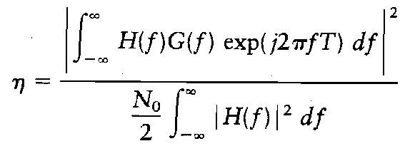
Matched Filter
Filter output is sampled at t=T, then
Power spectral density of output noise can be computed as
The average power of noise n(t) is given by
Thus η becomes

Slide 14
Matched Filter
According to Schwarz inequality, for two complex functions satisfying following conditions.
Then
It holds if and only if
Now apply schwarz inequality in our case. Let

Slide 15
Matched Filter
It shows peak pulse signal to noise ratio does not depend upon H(f),but on signal energy and noise power spectral density.
Thus, and
To obtain impulse response, take IFT of above equation.

Slide 16
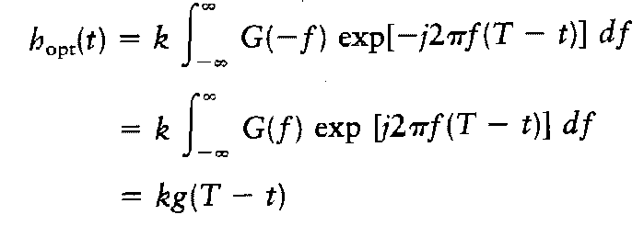
Matched Filter
For real signal g(t) thus equation become
Thus impulse response of optimum filter is time reversed and delayed version of input signal g(t).

Slide 17
Properties of Matched Filter
The peak pulse signal to noise ratio of matched filter depends on ratio of signal energy to power spectral density of the white noise at the filter input.
To prove above property,
At t=T

Slide 18
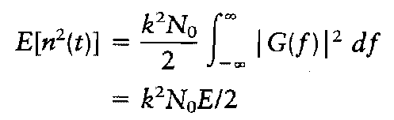
Properties of Matched Filter
The signal energy E of pulse signal can be defined as
Hence, Thus,
The maximum efficiency does not depends on waveform of input signal g(t).

